Slide 1
Neural Network Models in the Real World
Lesson 21.2

Slide 2
Class Objectives
By the end of this lesson, you will be able to:
Implement deep neural network models using TensorFlow.
Explain how different neural network structures change algorithm performance.
Save trained TensorFlow models for later use.

Slide 4
We Must Dig Deeper… Into Neural Networks

Slide 5
Over the Moon on Basic Neural Networks
10 Minutes
Notes:
📣 1.1 Everyone Do: Over the Moon on Basic Neural Networks (10 min)

Slide 6
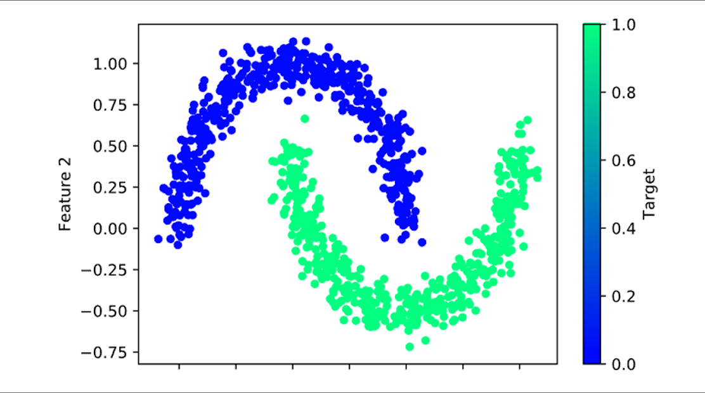
Over the Moon on Basic Neural Networks
Similar to the swirl input data we saw in TensorFlow Playground, the moons dataset (made from scikit-learn’s make_moons method) is not linearly separable.

Slide 7
Our next steps are exactly the same as those in the last class.

Slide 8
Over the Moon on Basic Neural Networks
Next steps:
Split the dataset, then scale and standardize each feature
Fit the model to our training data
Transform the data
Create a Sequential model
Add the first layer and output layer, and then get the structure of the Sequential model

Slide 9

Over the Moon on Basic Neural Networks
Depending on the dataset or the use case for the model, a predictive accuracy of approximately 85% may
be sufficient for a first-pass model.
85
%
Notes:
shutterstock_2142736057

Slide 10
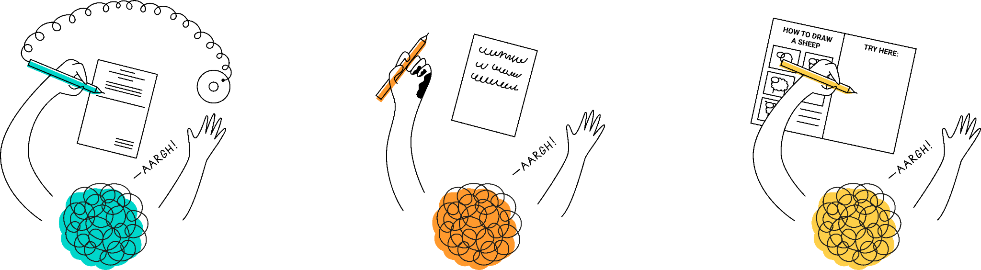
Over the Moon on Basic Neural Networks
For example, let’s say we were trying to build a neural network that can predict if students are left-handed or right-handed. A model that was able to make correct predictions 85% of the time would be pretty accurate!
Notes:
shutterstock_1756262042

Slide 11

Over the Moon on Basic Neural Networks
Many industrial and medical use cases require a machine learning model to exceed 95% or even 99% classification accuracy.
In these cases, we could not use the basic single-neuron, single-layer model.

Slide 12
Over the Moon on Basic Neural Networks
One possible solution to our performance problem is to add more neurons.
This is the most straightforward solution, but it is not the most robust.
Adding more neurons to a single hidden layer only boosts performance if there are subtle differences between values.

Slide 13
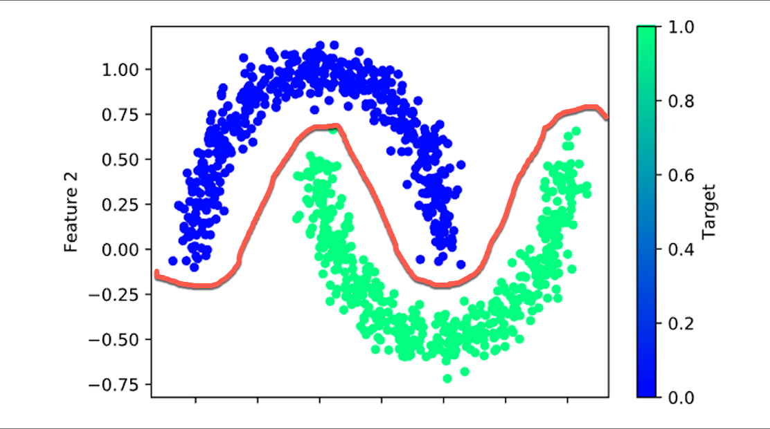
Over the Moon on Basic Neural Networks
For our dataset, the only way to separate the two groups is with a complex polynomial line. A single-layer, multiple-neuron model would still struggle to adequately classify our two groups with only two inputs.
In these cases, we must create a neural network model capable of identifying complex nonlinear relationships.

Slide 15
Getting Deep with Deep Learning Models
Notes:
📣 1.2 Instructor Do: Getting Deep with Deep Learning Models (10 min)

Slide 16
The Neural Network
Input
Hidden layer
Output
Basic neural network models are:
Designed to evaluate input values once before they are used in an output classification or regression equation.
Limited to interpreting simple linear relationships and data with few confounding factors, or factors that have hidden effects on more than one variable.

Slide 17
The Neural Network
To address and overcome the limitations of the basic neural network, we can implement a more robust neural network model by adding more hidden layers.
Input layer
Hidden layer 1
Hidden layer 2
Hidden layer 3
Output layer

Slide 18
A neural network model with more than one hidden layer is known as a deep neural network or deep learning model.

Slide 19
Deep learning models function similarly to the basic neural network, with one major difference.

Slide 20

Basic Neural Network vs. Deep Learning Model
The outputs of one hidden layer become the inputs to additional hidden layers of neurons. This enables the next layer of neurons to evaluate higher-order interactions between weighted variables and to identify complex, nonlinear relationships.
Basic Neural Network
Deep Learning Model
Input layer
Hidden layer 1
Output layer
Input layer
Hidden layer 1
Hidden layer 2
Hidden layer 3
Output layer

Slide 21
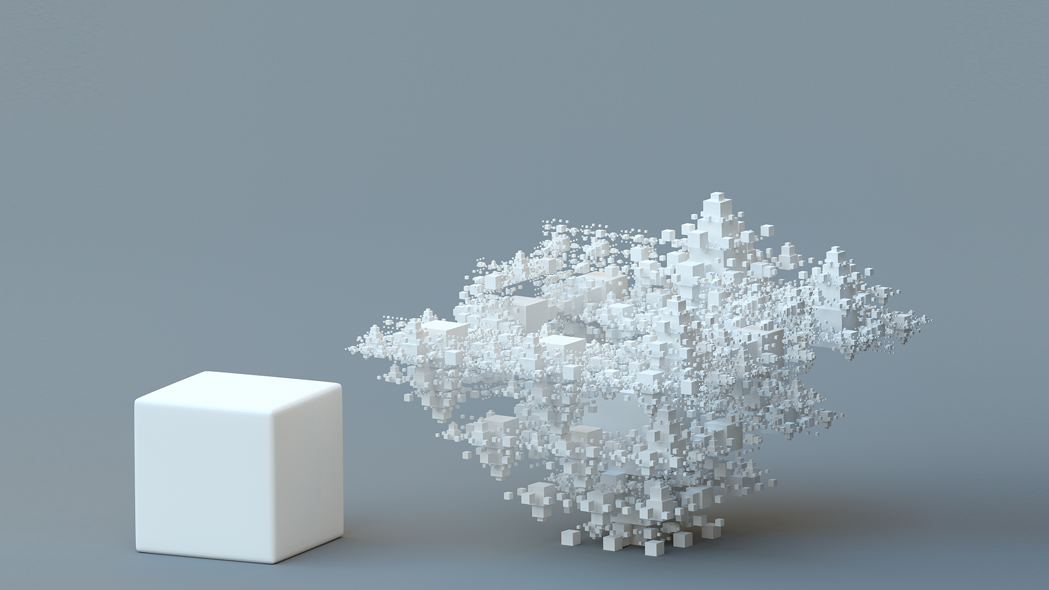
Getting Deep with Deep Learning Models
A deep learning model can identify and account for more information than any number of neurons in any single hidden layer.

Slide 22
Deep learning models are named for their ability to learn from example data, regardless of the complexity or data type.

Slide 23
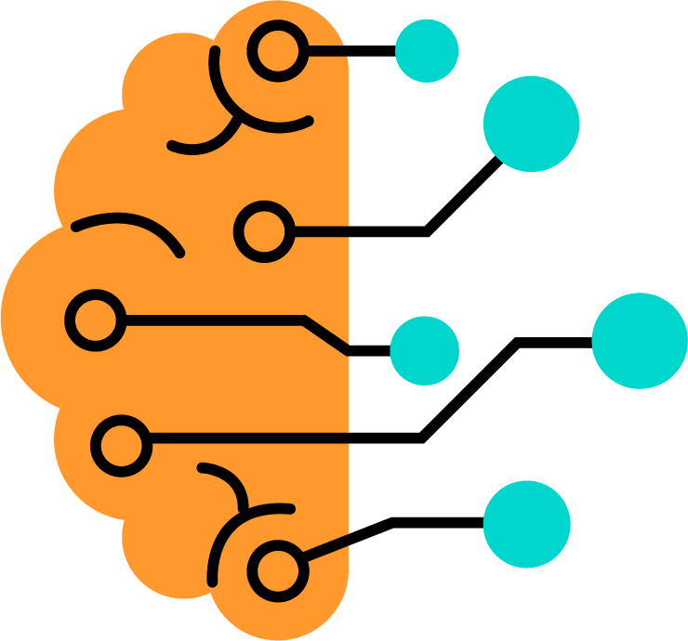
Features of Deep Learning Models
Just like humans, deep learning models can:
Identify patterns
Determine severity
Adapt to changing input data from a wide variety of source
Notes:
shutterstock_566808895

Slide 24

Getting Deep with Deep Learning Models
Many data scientists believe that even the most complex interactions can be characterized by as few as three hidden layers (there is an ongoing debate among scientists about this).
With minimal preprocessing and direction, deep learning models can train on:
Images
natural language data
soundwaves
traditional tabular data
Notes:
Shutterstock_83298601

Slide 25

Without access to powerful computers and libraries like TensorFlow, data scientists were limited in their ability to create and run complex models.

Slide 26

Deep Learning Models: TensorFlow
Deep learning models typically require longer training iterations and memory resources than their basic neural network counterparts, but they achieve higher degrees of accuracy and precision.
In other words, deep learning models may have more upfront costs, but they also have higher performance potential.
https://www.tensorflow.org

Slide 27
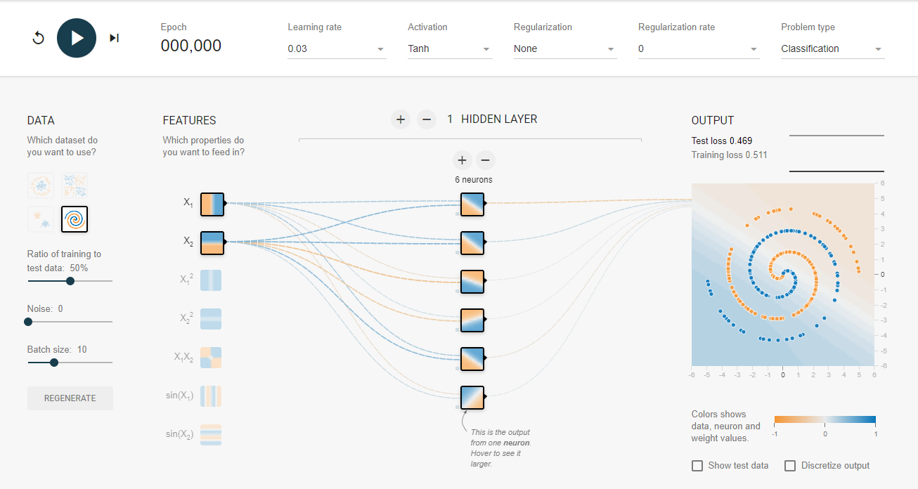
Deep Learning Models: TensorFlow
The easiest way to conceptualize the performance differences between basic neural networks and deep learning models is to return to the TensorFlow Playground.

Slide 28
There are drawbacks to building a deep learning model with too many layers.

Slide 29
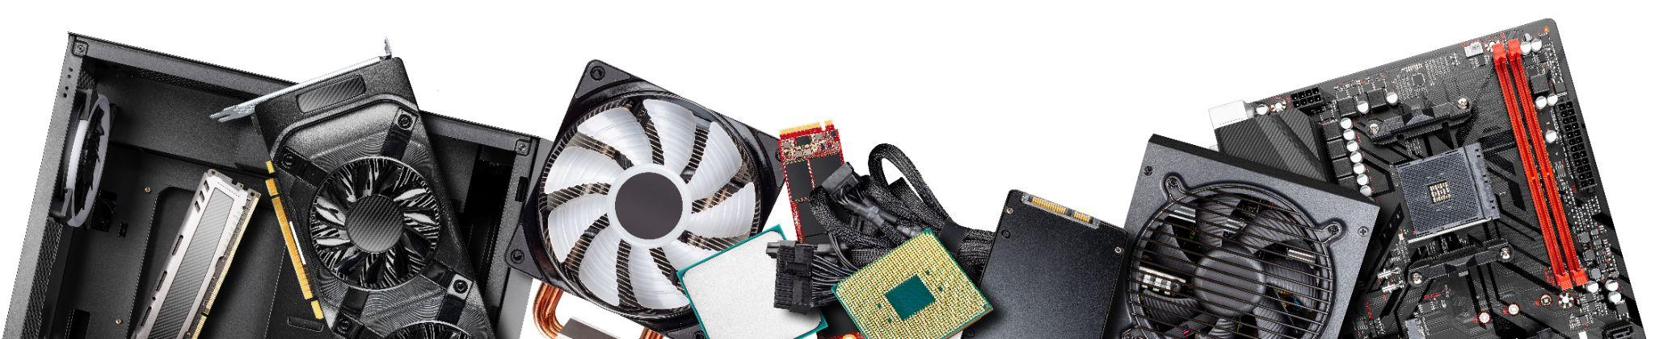
Drawbacks
Deep learning models:
Require more computational resources (memory and CPU power) for each layer. If we have limited resources or time, a larger deep learning model may not be possible.
Take considerably more time to train than a basic neural network. Each hidden layer adds complexity and more computations.
With multiple hidden layers will require more training data to produce an acceptable level of performance.
Notes:
shutterstock_2015717810

Slide 31
Activity: Back to the Moon
In this activity, you will build a deep learning classification model that can adequately predict the class from our moons dummy dataset.
20 Minutes
Notes:
⭐ 1.3 Students Do: Back to the Moon (20 min)

Slide 32
Activity: Back to the Moons
Instructions | Upload the starter notebook to Google Colab, and then run the cells to recreate the moons dummy dataset.
 | Create your Keras Sequential model and add more than one Dense hidden layer to create a deep learning model. Notes: Only your first Dense layer uses the input_dim parameter. All of your hidden layers should use the "ReLU" activation function.
 | Compile your model and train the deep learning model on at least 100 epochs.
 | Evaluate the performance of your model by calculating the loss and predictive accuracy of the model on your test dataset.
Bonus | If you have enough time, try recreating your deep learning model with a different set of hidden layers and neurons, and then evaluate the performance of your new model. Are you able to achieve 100% predictive accuracy?

Slide 33
Notes:
📣 1.4 Review: Picking Our Brains on Neural Networks (10 min)

Slide 35
Getting Hands On with Model Optimization
Notes:
📣 2.1 Instructor Do: Getting Hands On with Model Optimization (15 min)

Slide 36
As with any machine learning model, neural networks and deep learning models are not perfect.

Slide 37

There are two major pain points
that we will commonly encounter: overfitting and underfitting.

Slide 38
Overfitting
A model has high variance.
It adjusts too much to fit the training data and will not generalize well.
As a reminder, this is known as overfitting the model.
y
x
Overfitting

Slide 39
Underfitting
A model can have high bias.
Very noisy input data causes the model to underfit the data.
In other words, our model struggles to classify or predict our training dataset.
y
x
underfitting

Slide 40

Model Optimization: Overfitting
There are two reasons for the model to overfit the data and not meet performance expectations.
01
02
The training and test data are unbalanced or the training data are not representative of the test data.
There is not enough complexity in the training data, and the model converges too quickly.
We will discuss convergence in detail later in the lesson.

Slide 41
The most straightforward way to fix a high-variance (overfitting) model is by adding more training data.

Slide 42


Add More Training Data
The first way to increase the training data is to collect more data for your input dataset.
Pro
This is the safest method of increasing training data, but the data must be collected properly, using the same protocol as initial data collection.
Con
The problem with collecting more input data is that it might be logistically or financially impossible to collect more data.

Slide 43
Add more Training Data
The second method of increasing the training data is changing the split of training and testing data in the original input data.
Pro
The benefit of this method is that we won’t need to collect new data; there is no additional financial or logistical cost.
Con
We’ll have less data available for testing and validating the model. This creates a higher risk that we might incorrectly consider an underperforming model to be adequate.

Slide 44
Add More Training Data
We can keep our training data the same and retrain the model using fewer epochs.
Pro
This can be a safer alternative for smaller, simpler datasets.
Con
It may be ineffective for larger datasets with many features.

Slide 45
Model Optimization: Underfitting
There are two reasons for the model to underfit the data and not meet performance expectations.
01
02
The training data contains too many outliers/confusing variables.
Model design parameters, often referred to as hyperparameters, are inadequate/inappropriate.
We should always start by checking the training data because the process is fast and straightforward.

Slide 46
Reaction Times at a Baseball Batting Cage

Slide 47

Neural networks are tolerant of noisy characteristics in a dataset, but they can learn bad habits, too (like the brain does).
Notes:
shutterstock_2042284394

Slide 48
We have to identify the variables that contain a number of potential outliers.
These variables can affect our data preprocessing and cause more important variables and features to disappear.

Slide 49
Hyperparameters
We will focus on higher-level hyperparameters that can be altered to achieve desired performance, such as:
The number of neurons in a hidden layer
The number of hidden layers in a deep learning model
The activation function for each hidden layer
The number of epochs in the training regimen

Slide 50
Hyperparameters
There are general rules we can apply to our hyperparameter tuning to make our models more effective.
When building the initial model, we should use 2–3 times as many neurons as there are input features.
If this does not achieve desired performance, we can always add more neurons if we have the computational resources.
Hyperparameter
tuning
Best hyperparameters
Model training
Choosing between different model families
Model parameters

Slide 51
Hyperparameters
Similarly, we can try to boost the performance of a deep learning model by creating additional hidden layers.
Deep Learning Model
Input layer
Hidden layer 1
Hidden layer 2
Hidden layer 3
Output layer
Deep learning models require substantially more training iterations and memory resources with each additional hidden layer.
A good starting point for deep learning model optimization is limiting the model to 2–4 hidden layers.
Depending on the size and complexity of the input data, we may need to exceed the recommended number of hidden layers.

Slide 52
One of the most effective methods of optimizing our neural network and deep learning models is to alter the activation functions for each hidden layer.

Slide 53
Activation Functions
Depending on the shape and dimensionality of the input data, each activation function may focus on specific and different characteristics of the input values.
We need to use an activation function that matches the complexity of the input data. Each of the most popular activation functions has ideal use cases and datasets.
Sigmoid function
Tanh function
Rectified linear unit (ReLU)
Leaky ReLU function

Slide 54
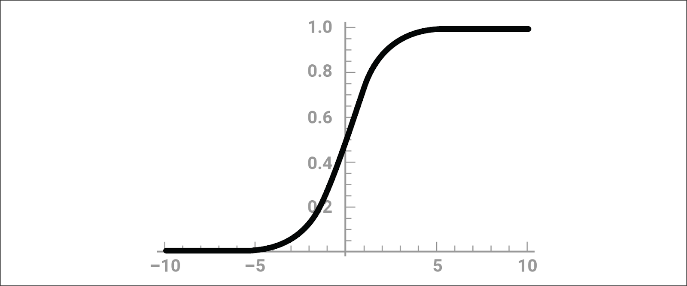
Sigmoid Function
The sigmoid function values are normalized to a probability between 0 and 1, which is ideal for a binary classification dataset.

Slide 55
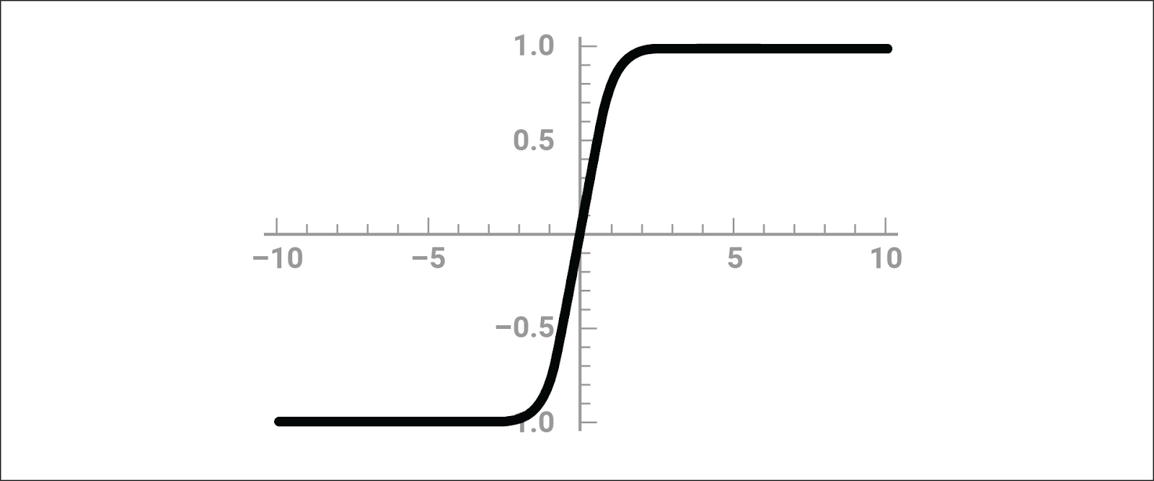
Tanh Function
We can use the tanh function for classification or regression because the normalized values range between –1 and 1.

Slide 56
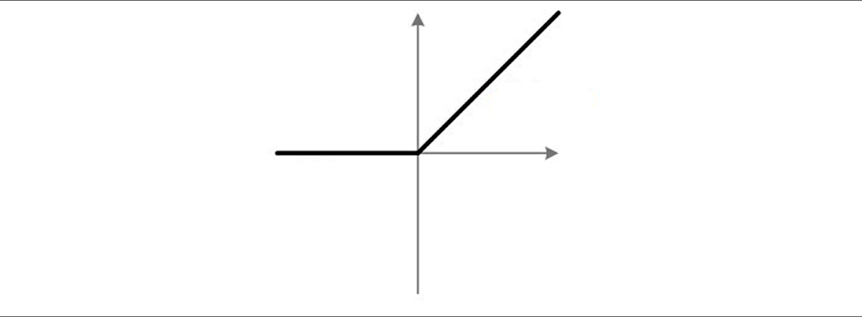
Rectified Linear Unit (ReLU)
The rectified linear unit (ReLU) function is ideal for modeling positive, nonlinear input data for classification or regression. The ReLU function is always a good starting point, but not all data are positive, especially when normalized.

Slide 57
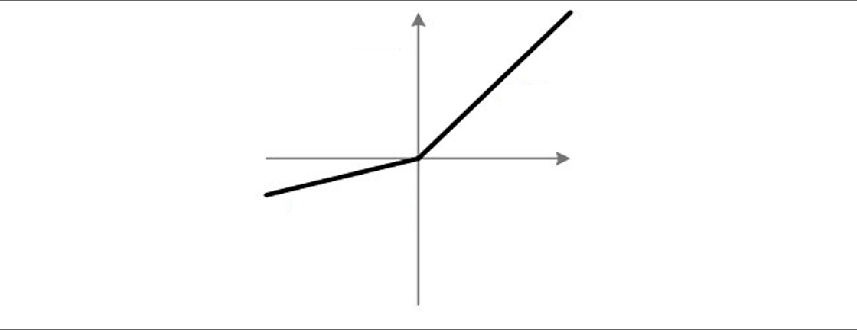
Leaky ReLU Function
The leaky ReLU function is a good alternative to the ReLU function because of its ability to characterize negative input values.

Slide 58
Activation Functions
It’s a good idea for the activation functions for your hidden layers to be slightly more complex than the activation functions for your output layer.
Using a higher-complexity activation function will assess the more complex components of the input data differently without any risk of censoring or ignoring lower-complexity features.

Slide 59
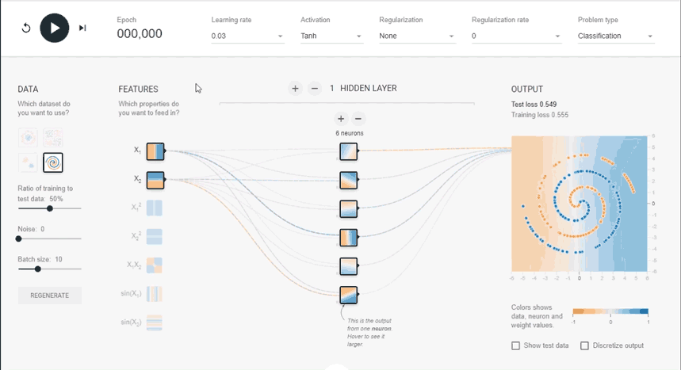
Epochs
If our model has still not met performance expectations, we can increase the number of training epochs.

Slide 60


Epochs
As the number of epochs increases, so does the amount of information provided to each neuron.
Each training iteration tweaks the neuron’s weight coefficients; therefore, each epoch increases the likelihood that the model is utilizing effective weight coefficients.

Slide 61
Epochs
If the model produces weight coefficients that are too effective at analyzing the training data (i.e., the model is custom tailored to meet the demands of the current data), then it may not generalize well.
As a reminder, this is known as overfitting the model.
y
We should test and evaluate our models each time that we increase the number of epochs to reduce the risk of overfitting.
x
Overfitting

Slide 62
A good idea:
Start with a smaller number of training epochs (such as 100) and add more epochs until training loss starts decreasing at a slower rate.

Slide 63
Epochs
This threshold for the number of epochs can vary greatly between datasets. For example, large datasets with hundreds of thousands of input values can start at 1,000 epochs (or even more!) without the risk of overfitting.
y
y
y
x
Just Right!
x
x
Underfitting
Overfitting

Slide 64
Model Optimization Techniques
Hyperparameter adjustment | Pros | Cons
Add more neurons | Speeds up model, may reduce loss | More computational resources required
Add more layers | Considers more interactions between variables | More computational resources required
Change activation function | Drastically changes how a model interprets inputs | Not all new interpretations are effective
Add more epochs | Increase likelihood that model will achieve optimal weight coefficients | Increased risk of overfitting
This list is not complete. There are more subtle and specific optimization tweaks that we can perform on TensorFlow neural network models.

Slide 66
Take the Guesswork Out of Model Optimization
Notes:
📣 2.2 Instructor Do: Take the Guesswork Out of Model Optimization (15 min)

Slide 67
Take the Guesswork Out of Model Optimization
Model optimization is often the most tedious and critical step in designing an effective machine learning model. Small changes to neural network model hyperparameters can cause large changes to overall model performance.
Hyper-parameter training

Slide 68

Take the Guesswork Out of Model Optimization
When developers released TensorFlow 2.0, they also released libraries and tools to automate neural network model optimization. These tools remove a lot of the guesswork for creating a nominal neural network and deep learning model.

Slide 69
Take the Guesswork Out of Model Optimization
Notes:
📣 2.2 Instructor Do: Take the Guesswork Out of Model Optimization (15 min)

Slide 71
Activity: Giving Your Model Building a Tune-Up
In this activity, you will use KerasTuner to create a model that can adequately predict scikit-learn’s make_circles dataset.
20 Minutes
Notes:
⭐ 2.3 Students Do: Giving Your Model Building a Tune-Up (20 min)

Slide 72
Activity: Giving Your Model Building a Tune-Up
Instructions | Run the starter code provided in Google Colab to create the circles dummy dataset.
 | Convert the circles dataset to a dataframe and plot the circles dataset using Pandas.
 | Create a method that creates and compiles a new Sequential deep learning model with hyperparameter options. Be sure to include the following features: Allow KerasTuner to select between ReLU and tanh activation functions for each hidden layer. Allow KerasTuner to decide from 1 to 30 neurons in the first dense layer. Note: To limit the tuner runtime, increase your step argument to at least 5. Allow KerasTuner to decide from 1 to 5 hidden layers and 1 to 30 neurons in each Dense layer.
 | Import the KerasTuner library and create a Hyperband tuner instance. Use the following parameters in your tuner: The objective is "val_accuracy" max_epochs equal to 20 hyperband_iterations equal to two.
 | Run the KerasTuner search for best hyperparameters over 20 epochs.
 | Retrieve the top three model hyperparameters from the tuner search and print the values.
 | Retrieve the top three models from the tuner search and compare their predictive accuracy against the test dataset.

Slide 73
Notes:
📣 2.4 Review: Giving Your Model Building a Tune-Up (10 min)

Slide 76
Getting Real with Neural Network Datasets
Notes:
⭐ 3.1 Instructor Do: Getting Real with Neural Network Datasets (20 min)

Slide 77
The last lesson of today’s class covers how to prepare real-world data for our neural network models.

Slide 78

When building machine learning models, most of the design effort goes into preprocessing and cleaning up the input data, not writing the code of the model; neural networks and deep learning models are no exception to this rule.
Notes:
shutterstock_471848861

Slide 79




Getting Real with Neural Network Datasets
In general, neural network models require the most preprocessing of input data as compared to other statistical and machine learning models.
Most neural networks are really good at identifying patterns and trends in data, but they are susceptible to getting stuck when looking at abstract or raw data.
When data have many categorical values, or large gaps between numerical values, a neural network might think that these variables are less important (or more important) than they really are.
Neural network
Logistic regression
Random forest
Decision tree
Notes:
shutterstock_1693205587

Slide 80
If a bank wanted to build a neural network model to identify if a company were eligible for a loan, it might look at factors such as a company’s net worth.

Slide 81



Getting Real with Neural Network Datasets
If the bank’s input dataset contained information from large Fortune 500 companies, such as Google and Facebook, as well as small family-owned stores, the variability in net worth would be huge.
Notes:
Scale: shutterstock_386582773 Logo: shutterstock_584601604

Slide 82
Getting Real with Neural Network Datasets
Without normalized input data, a neural network could look at net worth as being a strong indicator of loan eligibility and might ignore all other factors, such as:
Debt-to-income ratio
Credit status
Requested loan amount

Slide 83
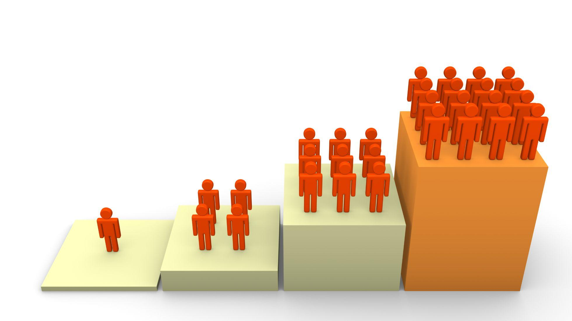
Getting Real with Neural Network Datasets
Instead, if the net worth were normalized on a factor such as number of employees, the neural network would be more likely to weigh other factors more evenly with net worth.
This would result in a neural network model that assesses loan eligibility more fairly, without introducing any additional risk.

Slide 84
Preprocessing the Input Data
We alter the input dataset before any computational model training or evaluation.
When working with a neural network, we must first preprocess the categorical data before we preprocess the numerical data.
Data Types
Categorical
Numerical
Nominal
Ordinal
Interval
Ratio
Notes:
shutterstock_1087674545_

Slide 85

Preprocessing the Input Data
We can preprocess our categorical data using the one-hot encoding method from scikit-learn.
One-hot encoding identifies all unique column values and then splits a single categorical column into a series of columns.
Each column contains information about a single unique categorical value.
Notes:
shutterstock_1087674545_

Slide 86
Preprocessing the Input Data
Eye_Color
Blue
Brown
Brown
Brown
Hazel
Green
Hazel
Brown
Blue
Brown
Consider the following eye_color variable containing a list of eye colors from different people.

Slide 87
Preprocessing the Input Data
This table is the exact same eye_color variable encoded using one-hot encoding.
Each row has only one column with a value of 1—the corresponding categorical variable from the original dataset.
This binary encoding ensures that each neuron receives the same amount of information from the categorical variable.
Now the neural network will interpret each value independently and provide each categorical value its own weight in the algorithm.
Eye_Color: Blue | Eye_Color: Brown | Eye_Color: Hazel | Eye_Color: Green
1 | 0 | 0 | 0
0 | 1 | 0 | 0
0 | 1 | 0 | 0
0 | 1 | 0 | 0
0 | 0 | 1 | 0
0 | 0 | 0 | 1
0 | 0 | 1 | 0
0 | 1 | 0 | 0
1 | 0 | 0 | 0
0 | 1 | 0 | 0

Slide 88
One-hot encoding is a very robust solution, but it can be memory-intensive.

Slide 89
Preprocessing the Input Data
Categorical variables with a large number of unique values (or very large variables with only a few unique values) might become difficult to navigate or filter once encoded.
To address the issue of memory resourcing, we must reduce the number of unique values in the categorical variables.
Data Types
Categorical
Numerical
Nominal
Ordinal
Interval
Ratio
Notes:
shutterstock_1087674545_

Slide 90
The process of reducing the number of unique categorical values in a dataset is known as bucketing or binning.

Slide 91
Bucketing
There two approaches to bucketing categorical data:
Approach #1
Approach #2
Collapse all of the infrequent and rare categorical values into a single “other” category.
This approach takes advantage of the fact that uncommon categories and “edge cases” are rarely statistically significant.
Create generalized categorical values and reassign all data points to the new corresponding values.
This approach collapses the number of unique categorical values and maintains relative order and magnitude.
This particularly useful when we have categorical variables whose distribution of unique values is relatively even.

Slide 92
Bucketing
Regression and classification models typically cannot use rare categorical values to produce robust models.
vs.
Regression
Classification
Patients
Healthy weight
Overweight

Slide 93
Bucketing
Bucketing is less effective when there are only a few unique values.
You should only apply a bucketing strategy when the categorical variables contain 10 or more unique values.
Green | Brown | Hazel | Blue | Gold | Purple | Orange | Red | Black | Pink
1 | 2 | 3 | 4 | 5 | 6 | 7 | 8 | 9 | 10
Notes:
shutterstock_1087674545_

Slide 94
Preprocessing the Input Data
After we encode all categorical variables using one-hot encoding, all the variables in our dataset will now be numeric.
Neural network models are not designed to handle categorical data, but they can interpret and evaluate all forms of numerical data.
Neural network models can train on raw numerical data, but training them on raw data often is not a good idea.
Data Types
Categorical
Numerical
Nominal
Ordinal
Interval
Ratio
Notes:
shutterstock_1087674545_

Slide 95
Preprocessing the Input Data
Raw data often has outliers or extreme values that can artificially inflate a variable’s importance.
Numerical data can be measured using different units across a dataset—such as time versus temperature or length versus volume.
The distribution of a variable can be skewed, which results in misinterpretation of the central tendency.

Slide 96
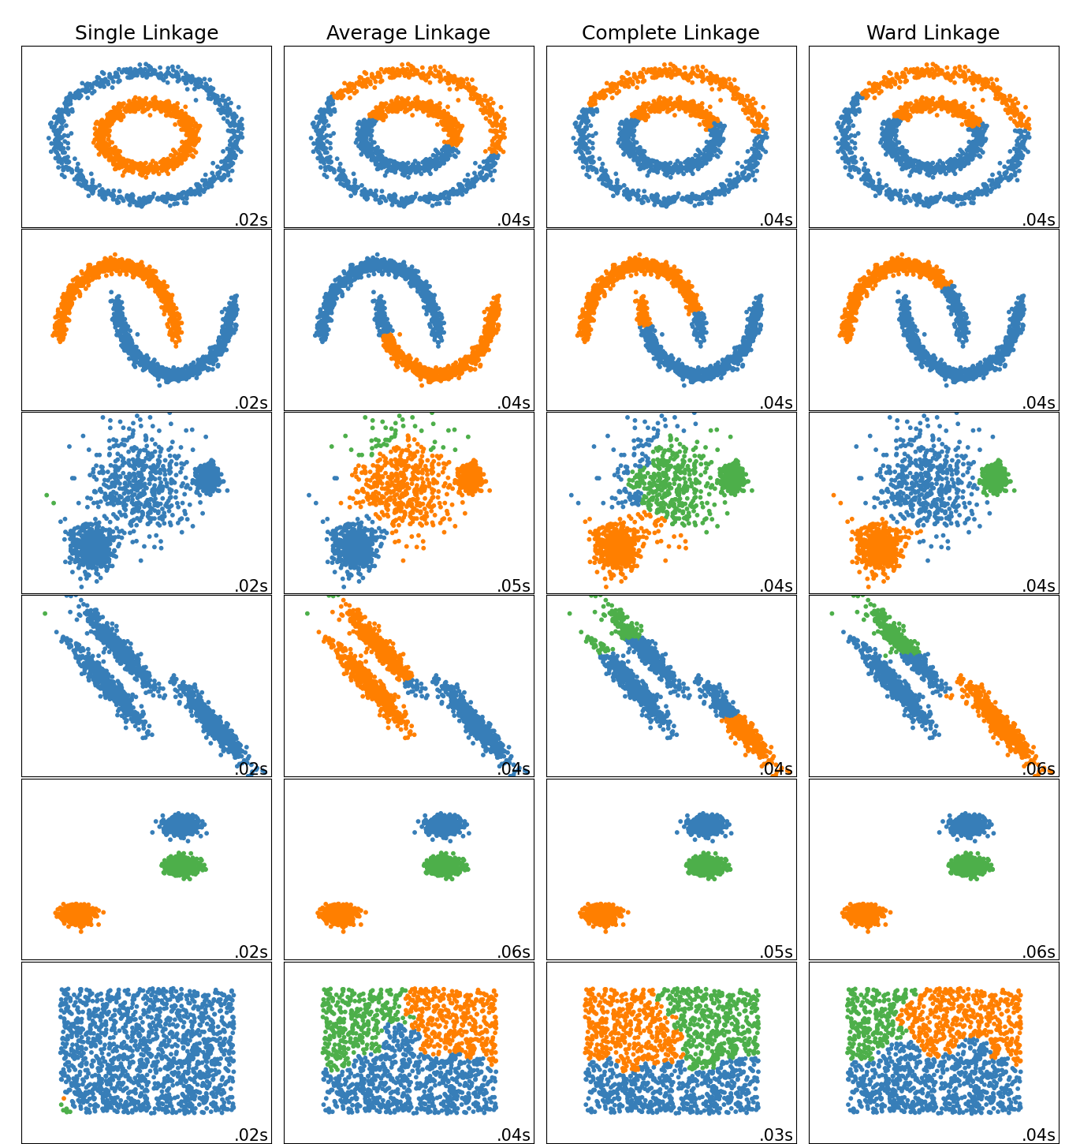
Preprocessing the Input Data
The easiest way to minimize the risks associated with raw numerical data is to standardize the numerical data prior to training.
In Python, we can standardize the numerical data using scikit-learn’s StandardScaler module.
By using StandardScaler to standardize our numerical variables, we reduce the overall likelihood that outliers, variables of different units, or skewed distributions will have a negative impact on a model’s performance.
https://scikit-learn.org

Slide 97
IBM Employee Data
https://www.kaggle.com/

Slide 98


Preprocessing Neural Network Input Data
Are there categorical features?
Does any feature have >10 unique values?
Are there a bunch of rare unique values?
Yes
Yes
No
No
Yes
No
Split input data into training and test datasets
One-hot encode categorical data and replace in put dataset
Bucket all rare unique values into an “other” category
Bucket using generalized categorical values
Create StandardScalar instance
Fit StandardScalar on training features
Scale training and test feature set

Slide 100
Activity: Detecting Myopia through Deep Learning
In this activity, you will preprocess a medical dataset and create a deep learning model that can predict whether a patient will be diagnosed with myopia.
20 Minutes
Notes:
⭐ 3.2 Student Do: Detecting Diabetes through Deep Learning (20 min)

Slide 101
Activity: Detecting Myopia through Deep Learning
Instructions | Upload the starter notebook to Google Colab, and then run the code to import the dependencies and load the diabetes dataset.
 | Separate the myopia MYOPIC target from the other features in the dataset.
 | Split the features and target into training and test datasets.
 | Preprocess the input data: If preprocessing categorical data, use scikit-learn’s OneHotEncoder module. If preprocessing numerical data, use scikit-learn’s StandardScaler module.
 | Define a deep learning model with the following features: A first Dense layer with eight inputs and the ReLU activation function A second Dense layer with eight or more neurons and the ReLU activation function An output layer with one neuron and the sigmoid activation function
 | Compile and train the model across no more than 100 epochs.
 | Evaluate the performance of the deep learning model by calculating the test loss and predictive accuracy.

Slide 102
Notes:
📣 3.3 Review: Detecting Diabetes Through Deep Learning (10 min)

